Slide 1

Network Analysis
ADS-516
Dr. Suat ATAN
Week:4

Slide 2
Lecture plan
Basic Network Plotting and Layout
Design Principles for Visualization
Design Elements
Effective Design

Slide 3
Basic Network Plotting and Layout
Notes:
So far we have plotted dozens of graphs -> go further
he overall purpose of a network graphic (as with
any information graphic) is to highlight the important information contained in the
underlying data. However, there are innumerable ways to visually layout network
nodes and ties in two-dimensional space, as well as using graphical elements (e.g.,
node size, line color, figure legend, etc.) to communicate the story in the network
data. In the next three chapters we go over basic principles of effective network
graph design, and how to produce effective network visualizations in R.

Slide 4
An effective and clear network graphic
Convey the critical information:
Overall Structure of network
Location of important nodes
Presence of subgroups (if available)
-Minimize irrelevant information

Slide 5
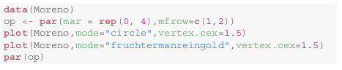
Basic Plotting
Notes:
The purpose of this lecture is to introduce basic plotting techniques for networks
in R, and discuss the various options for specifying the layout of the network on
the screen or page. This example shows how interpretation of a network
graphic can be impeded or enhanced by its basic layout.
We will plot in two ways

Slide 6
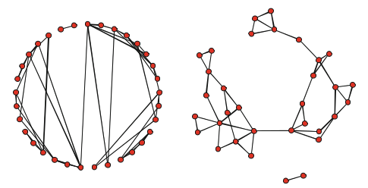
Is both are same?
Notes:
At first glance it may appear that the figures are showing two quite different networks. In fact, they are two different visual representations of the same underlying social network.
In
particular, it is much easier to see that the network is made up of two separate components, and that the large component has two fairly distinct cohesive subgroups.That is, the important structural characteristics of the network are easier to determine with the second layout compared to the first.
Although it is possible to lay out a network in 3D-space, the vast majority of
network visualizations are two-dimensional. Nodes are represented by shapes, typ-
ically circles, and ties are represented by straight or sometimes curved lines. The lines themselves can be tricky to interpret

Slide 7
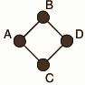
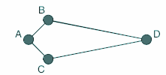
Line length
Notes:
In particular, the length of the line has no real meaning. Consider these two
two graphs, which display the same simple network (Fig. 4.2). At a quick glance it
might appear that node D is further away from B and C in the second graph. But the
ties simply indicate which nodes are adjacent to one another, so the length of each
line does not communicate any substantive information.

Slide 8
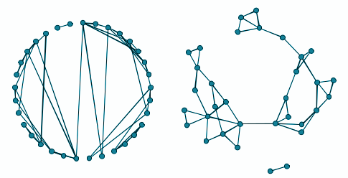
Obscuring information by layout
Notes:
However, as the Moreno 4th grade friendship network example illustrated
(Fig. 4.1), despite the arbitrary nature of some of the layout elements, the way a
network is depicted in a graphic can enhance or obscure other important structural
information

Slide 9
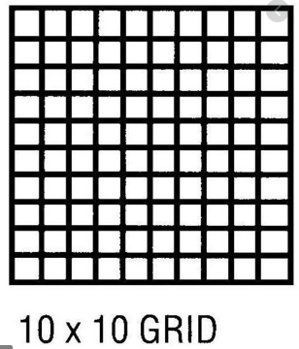
The Aesthetics of Network Layouts
50 Nodes
First node: 1/100 alternative place
Second node: 1/99
alternative place
...
Notes:
Although there are not in fact an infinite number of ways to display a network on
a screen, the number of possibilities might as well be. (For example, consider a
moderate sized network of 50 nodes, and a display grid of 10 by 10. In actuality,
the display grid would be much larger than this.
The first node in the network could be placed in any one of 100 positions, the 2nd node in 99 positions, and so on.
In this example, there are 3.1 × 10 93 different possible network layouts.) Most of
the possibilities will produce ugly or confusing layouts, therefore there must be
some way to pick a layout that has a better than average chance of being visually
acceptable.

Slide 10
Network Visualization Guidelines
Maximize the symmetry of the layout of nodes.
Minimize edge crossings.
Minimize the variability of the edge lengths.
Maximize the angle between edges when they cross or join nodes.
Minimize the total space used for the network display.
Network Analysis (Luke and Douglas, 2015)
Notes:
Fortunately, network and visualization scientists have studied what makes network
graph layouts easier to understand and interpret. What has emerged from this line of
work is a set of aesthetic principles that can be used to more effectively display net-
works. Network graphics are easier to understand if they follow as much as possible
the following five guidelines:

Slide 11
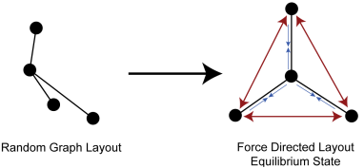
Force-Directed Algorithms
Notes:
Force-directed graph drawing algorithms are a class of algorithms for drawing graphs in an aesthetically-pleasing way. Their purpose is to position the nodes of a graph in two-dimensional or three-dimensional space so that all the edges are of more or less equal length and there are as few crossing edges as possible,

Slide 12
Random Layout
plot(g,layout=layout_randomly(g))

Slide 13
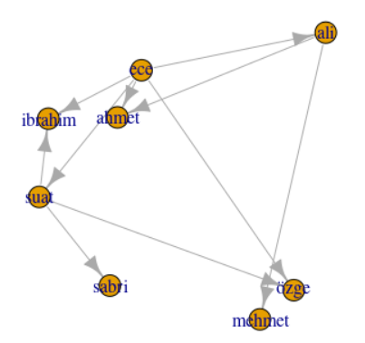
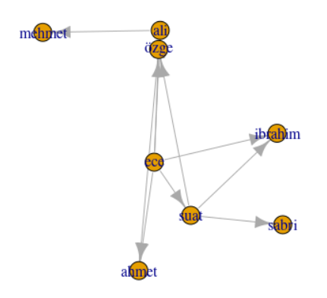
Random Layout
Notes:
Random for each run
Sometimes messy
Freeze by set.seed function

Slide 14
Fruchterman-Reingold Algorithm
Fruchterman and Reingold introduced one of the first force-directed network display algorithms, and it is still very widely used.
plot(g,
layout=layout.fruchterman.reingold(g))

Slide 15
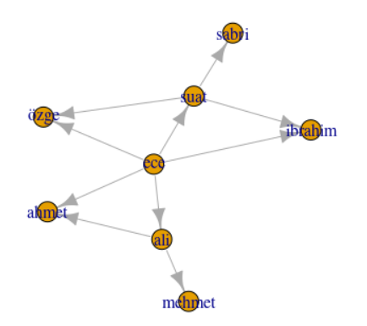
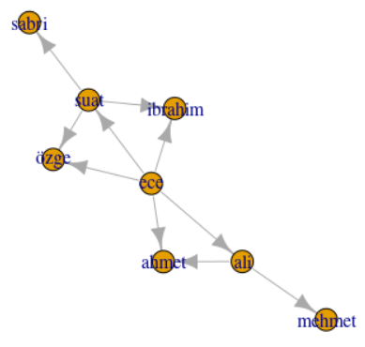
Fruchterman-Reingold Algorithm
Notes:
The Fruchterman-Reingold algorithm, along with other force-directed approaches,
are iterative and non-deterministic. That means that each time you run the plotting
algorithm you will not get the exact same layout. However, you will get a layout
that tends to be symmetrical, minimize edge crossings, etc.

Slide 16
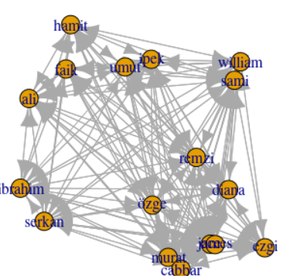
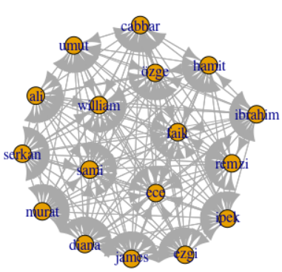
Comparison of layout algorithms on bigger network (03.csv)
Notes:
Left one : random
Right one: fruchterman reingold
Notice the connection distances. Left one makes us as if there is a subgroups or poles but there is not.

Slide 17
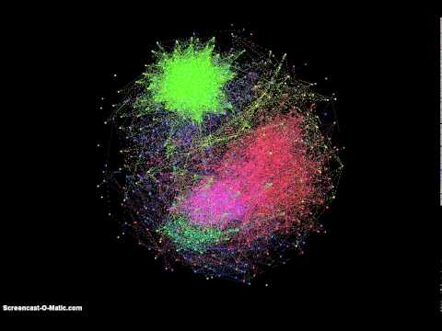
Iterations of Fruchterman Reingold Algorithm

Slide 18
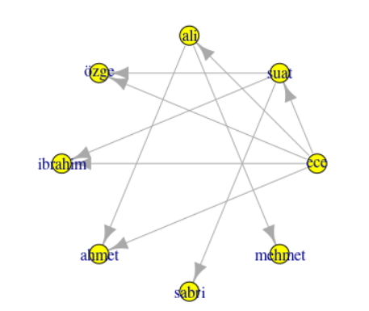
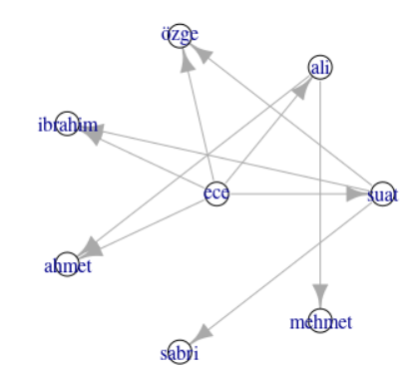
Notes:
Same network
Center of star and circle

Slide 19
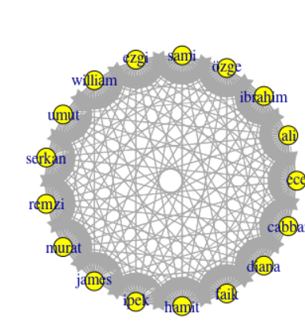
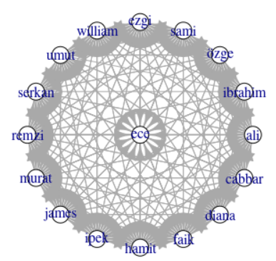
Circle vs. Star
Notes:
For bigger network 03.csv
See pattern

Slide 20
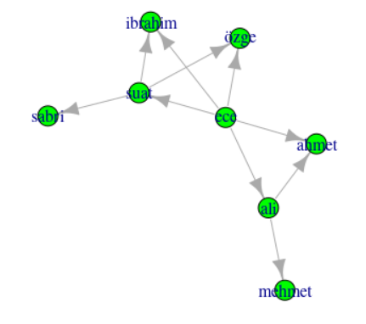
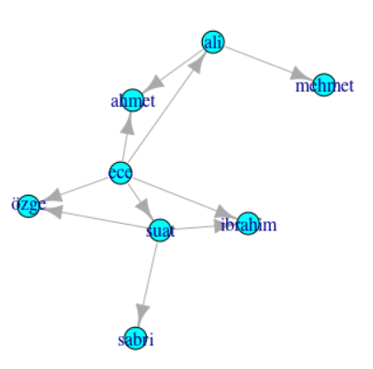
Davidson-Harel vs. DRL

Slide 21
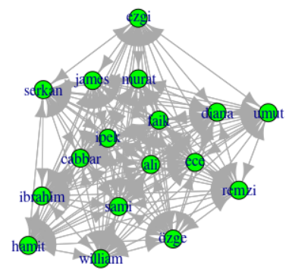
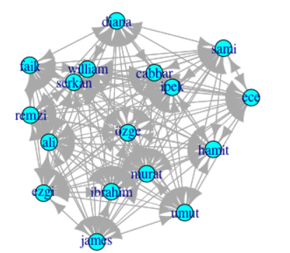
Davidson-Harel vs. DRL
Notes:
For bigger network
Hard to see difference but just for this
Difference in different network

Slide 22
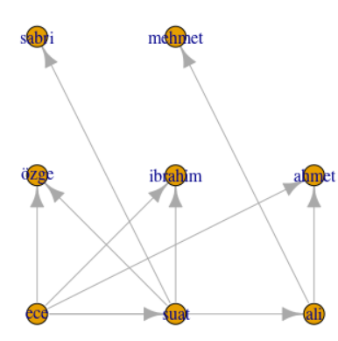
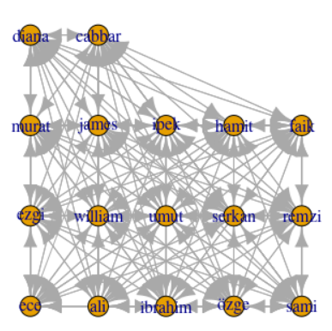
Grid Layout
Notes:
data 2 and 3 csv

Slide 23
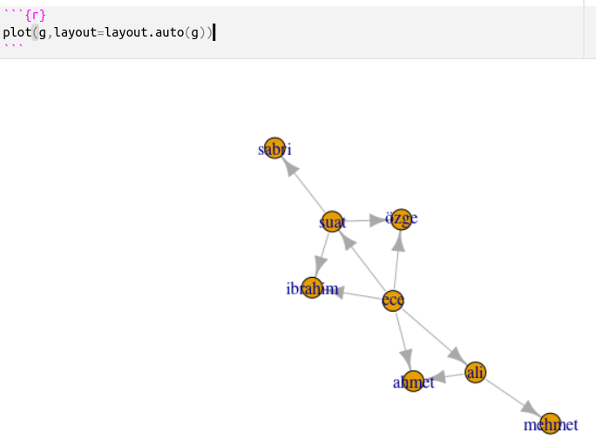
Layout Auto

Slide 24
Design Principles for Visualization

Slide 25
Effective Design for Visualization
“Graphical excellence is that which gives to the viewer the greatest number of ideas in the shortest time with the least ink in the smallest space.”
Edward Tufte - The Visual Display of Quantitative Information
However, ideas shout be about data not about your skills or intelligence or about “newfangled” tool.
Notes:
The goal for any network graphic design should be to produce a figure that reveals
the important or interesting information that is contained in the network data. To
do this, the analyst must make decisions about every graphical element that can
appear in the figure.
R, and the plotting functions contained in the statnet and
igraph packages, give the analyst almost complete programmatic control over the
appearance of the network graphic

Slide 26
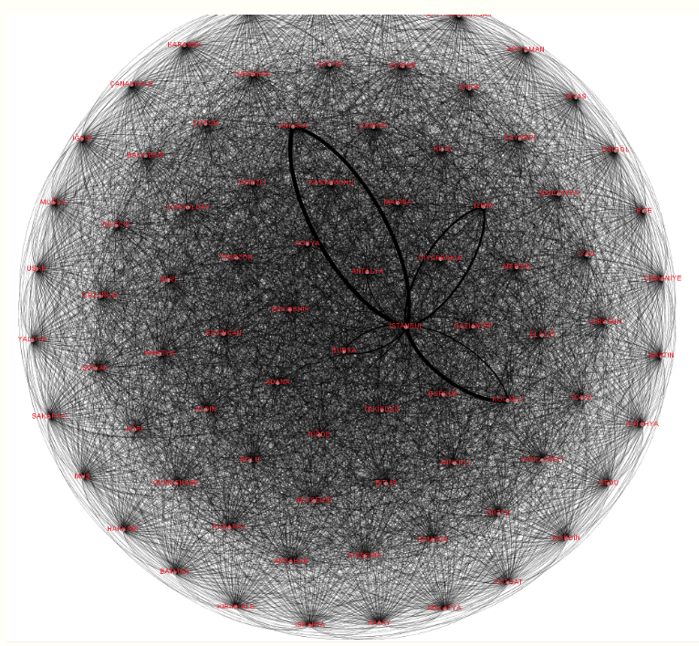
An Example 1
https://rpubs.com/suatatan/tiata-2017
Notes:
So big:
what is the information: This network is messy
It was about trading between cities in turkey

Slide 27
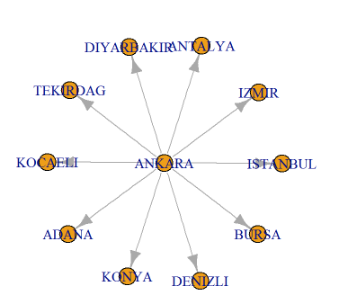
An Example 2
https://rpubs.com/suatatan/tiata-2017
Notes:
We have filtered small value relateions

Slide 28
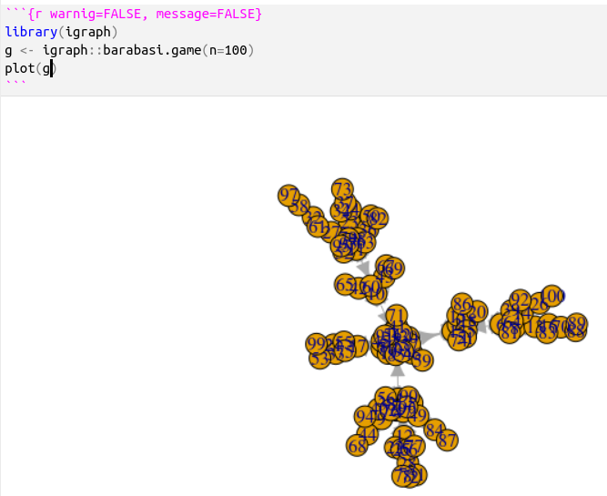
Direct Plot and Poor Design
Focus on:
Tangled nodes
Wrong size
Wrong color
Unreadable labels
Wrong position
Wrong color
Wrong size
Indiscernible arrows
Wrong arrow size
Layout
Could be better
Notes:
We generated a random graph with special function
We will focus on next weeks.
Although a simple call to a plotting function is enough to produce a default net-
work graphic, it is almost always the case that you will need to take time to set
appropriate function options and develop some additional R code to produce an
effective graphic. Some design decisions will be made on aesthetic grounds, while
many others will be based on the most important pattern or story that you wish to
convey with the graphic and that is supported by the underlying network data.

Slide 29
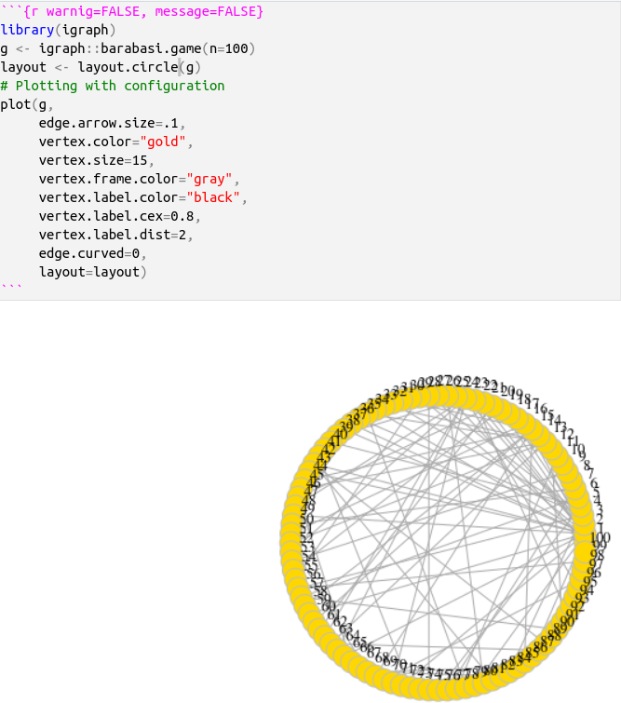
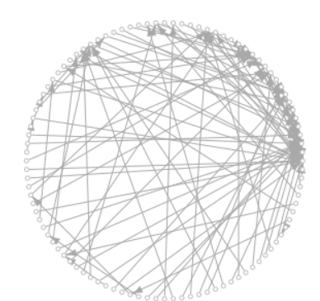
Unsuccessfull Stylized Plot Examples
Notes:
Right oe one is stylized
Left size is better even deleting label names and enlarge the ends of the arrows

Slide 30
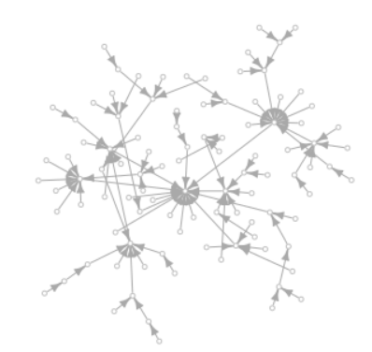
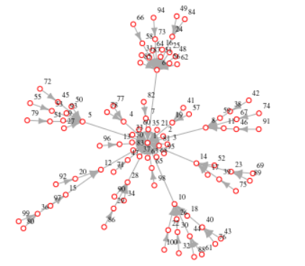
Davidson Harel vs. Auto Layout
Notes:
We tried most of layout but dind’t work.
We tried auto and see the hierarchy. It is a information
We can split into pieces

Slide 31
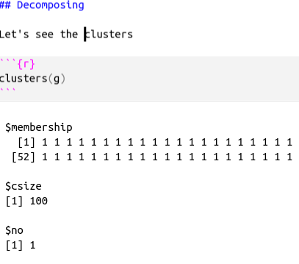
A strategy: decompose to see
For networks includes several submodules we can decompose by decomposing
But we can’t because everything are connected

Slide 32
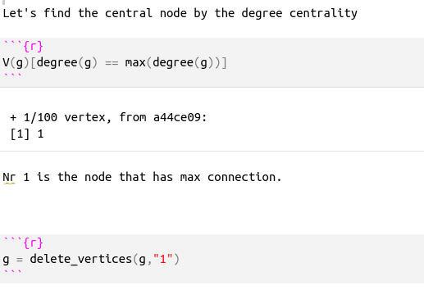
Dethrone the king and behold the courtiers
Find the node that has the most connection
Delete the node that has the most connection

Slide 33
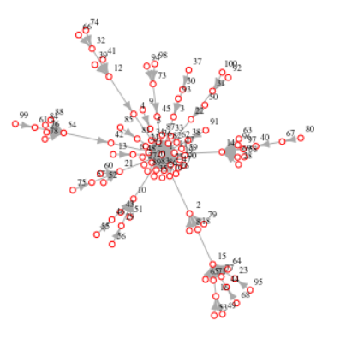
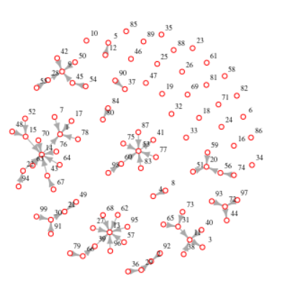
Effect of dethroning the king
Loyal servants of the king
King
A community (subgroup)
Notes:
See subgroups
Powerful teams
Get rid of loyal servants

Slide 34
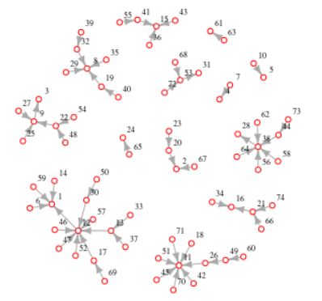
Get rid of the loyal servants of the deposed king
Isolated = which(degree(g)==0)
g_post_king = delete.vertices(g, Isolated)
Notes:
We get clear version of the network

Slide 35
More information with the variants
Notes:
Keeping this two network together may help explain the more

Slide 36
Design Elements

Slide 37
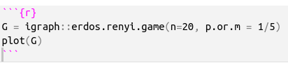
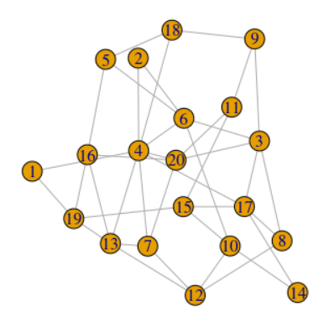
Node color
Notes:
Explain erdos renyi and possibility
Default color orange
default vertex label is blue

Slide 38
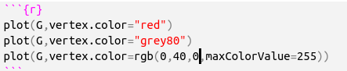
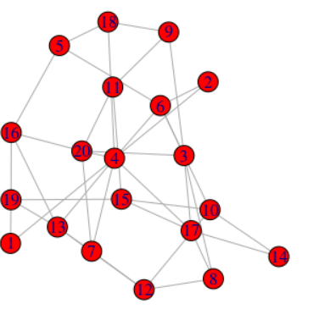
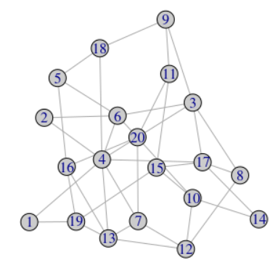
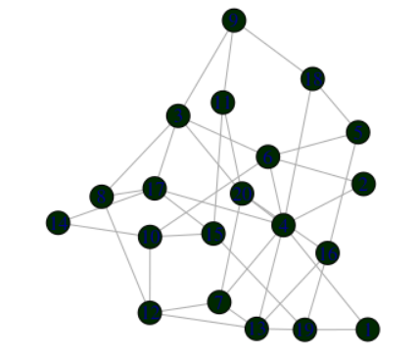
Node Color

Slide 39
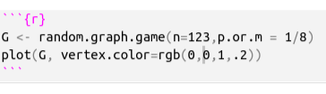
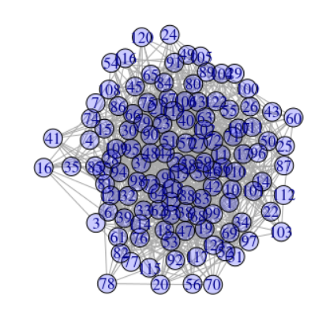
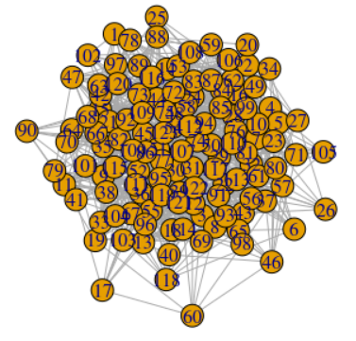
Opacity
1: opaque
0:clear
Notes:
Good solution for overlapping nodes

Slide 40
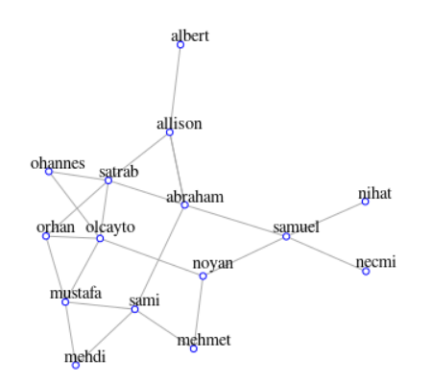
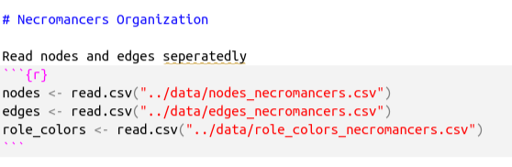
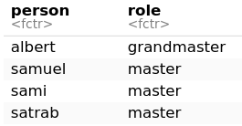
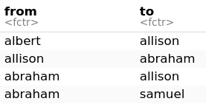

Node Coloring
Notes:
Without coloring no info

Slide 41


Assign the attributes to nodes
Notes:
Explain line by line

Slide 42

Show node attributes

Slide 43

Setting the node colors by attributes

Slide 44

Other node attributes
Node size
Default
By degree
Node shape
By attribute
Node label
Big
Small
No label
Distance of label from the node
Node frame color
#to show assigned attributes
list.vertex.attributes(ng)

Slide 45

Plotting parameters
https://kateto.net/netscix2016.html

Slide 46


Plotting parameters
https://kateto.net/netscix2016.html
Notes:
edge colors

Slide 47
The End
Dr. Suat ATAN

